Slide 1

Plant Leaf Disease Detection and Classification Using AI
Major Project Presentation
Mentor: Ms Rati Goyal
SHIKHAR SHARMA PIYUSH PANDEY UJJWAL SINGH YASH SRIVASTAVA

Slide 2
Introduction
Overview of the project
Detecting plant diseases early helps prevent crop losses and ensures food security
AI enables faster and more accurate diagnosis compared to traditional methods
Computer vision and deep learning techniques improve disease classification efficiency

Slide 3
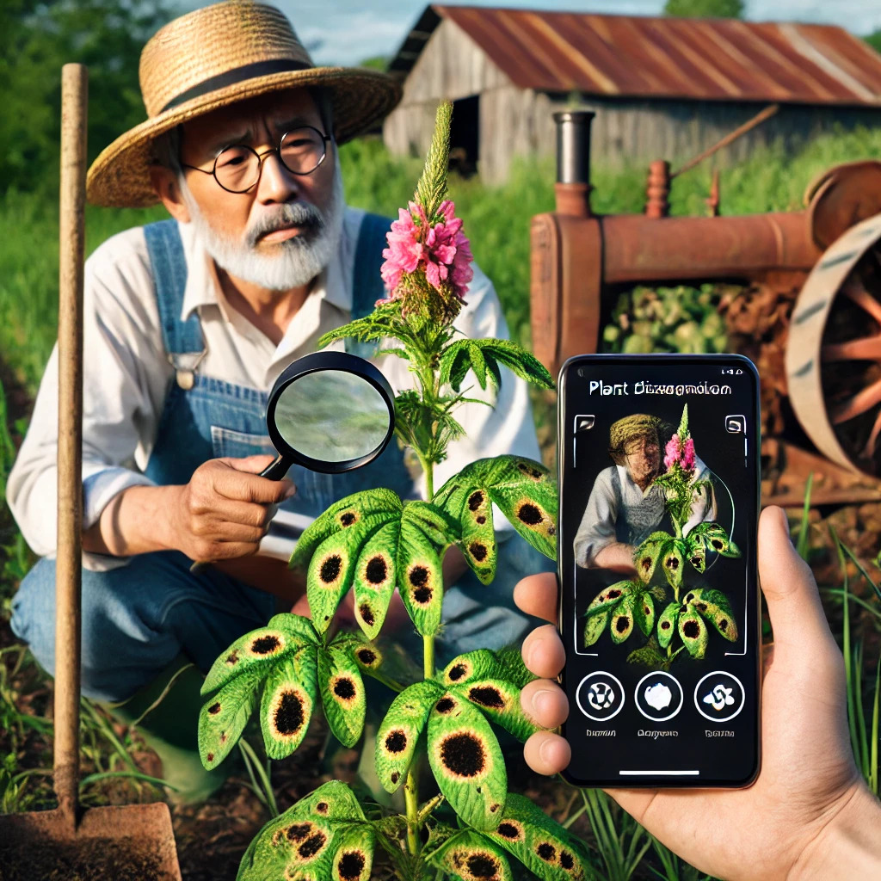
Problem Statement
Farmers struggle with identifying plant diseases early also traditional methods are time-consuming and inaccurate. Hence there is a need for an automated, AI-driven solution.

Slide 4
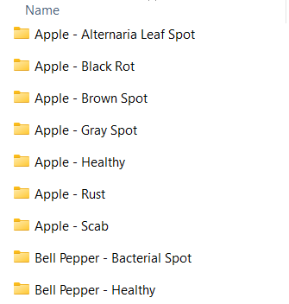
Dataset Description
Dataset: 'plant_data' containing 72 folders (each representing a different disease)
Each folder contains images of leaves affected by that disease. There are over 1 lakh leaf images in the dataset.
There are also sample images to test the model

Slide 5
Data Preprocessing
Transformations applied:
Resize to (128x128)
Convert to Tensor
Normalize Images
Random Horizontal Flip
Random Rotation
Splitting dataset: 80% Training, 20% Testing
Data Augmentation for better generalization

Slide 6
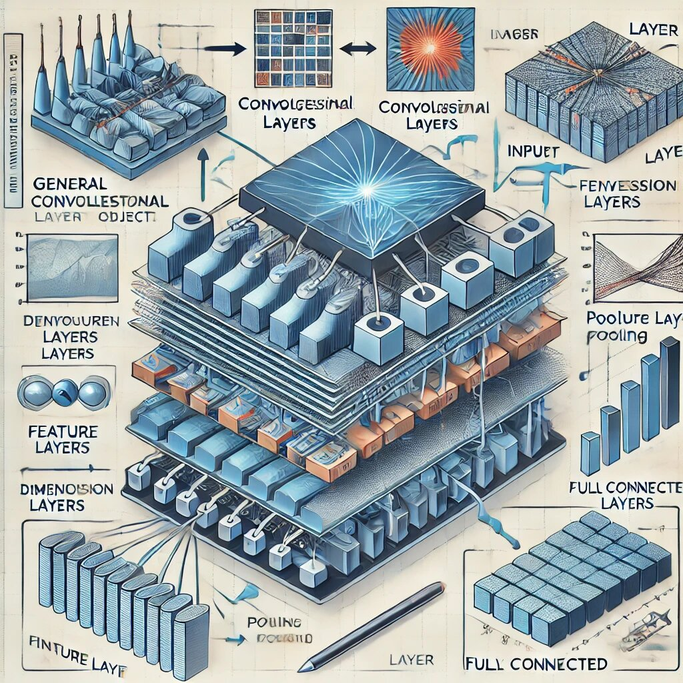
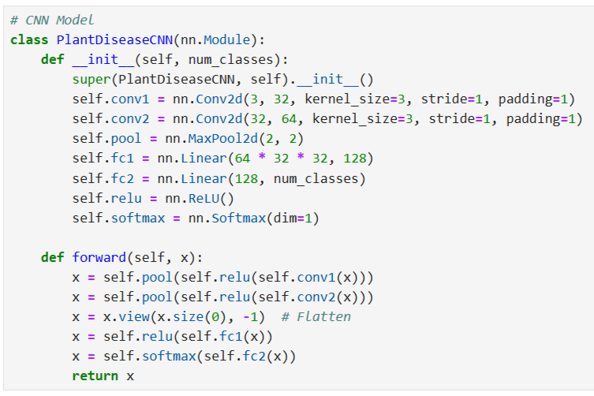
CNN Model Architecture
Activation Functions Used: ReLU, Softmax

Slide 7
Deployment Using Flask
Model saved as 'plant_disease_cnn.pth'
Web application built using Flask
User uploads an image
Model predicts the disease
Displays result on webpage

Slide 8
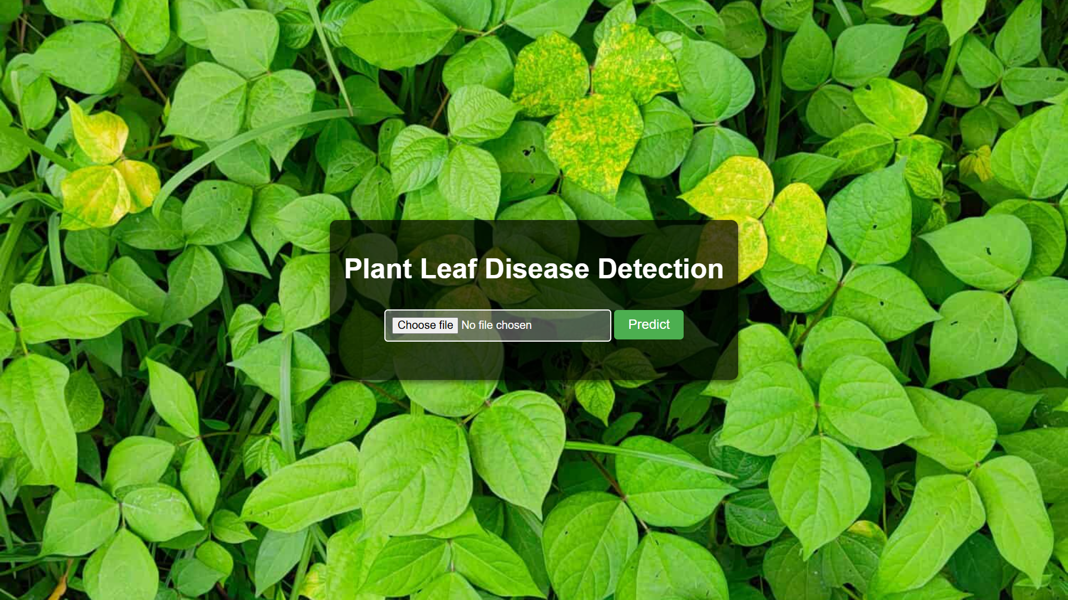
Web Interface
User choses the leaf image file
Click ‘Upload & Predict’ button to see the result

Slide 9
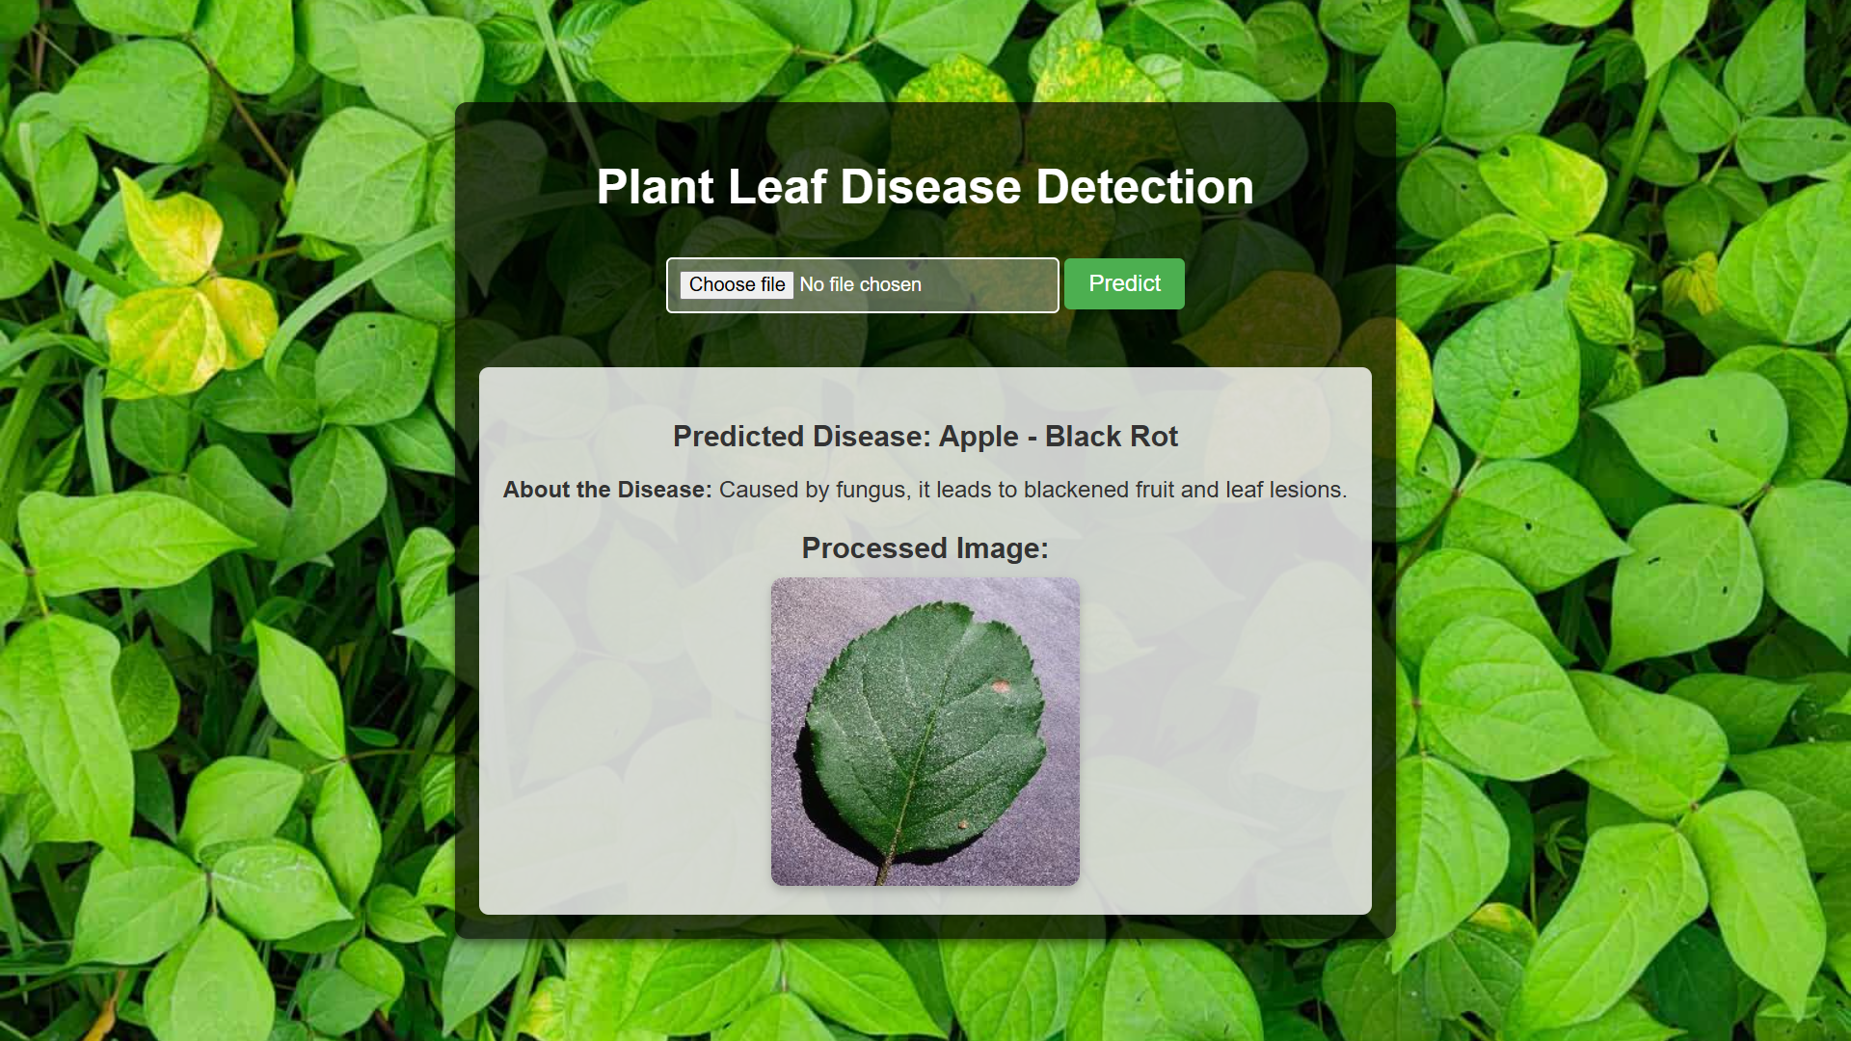
The Output
User sees their chosen image and the predicted disease

Slide 10
Challenges
Wrong predictions for external images
There is a scope of further improvement in model’s performance
Hosting the webpage for end users
Development of a mobile application

Slide 11
Future Improvements
Additional information about the disease (causes, prevention, etc.) will also be provided
Increase dataset size with more real-world images
Using other machine learning models to compare performance.
Optimize model for mobile applications
Extend classification to suggest treatment solutions
Implementation of other models like Yolov8 for object detection

Slide 12
Conclusion
Summary of the project – Detection & Classification of plant leaf diseases using AI. It emphasizes the importance of early detection in agriculture and how deep learning techniques were leveraged for accurate classification.
AI helps in plant disease detection – AI-based models, particularly CNNs, process leaf images to classify diseases quickly and accurately compared to traditional manual methods.
Future scope and improvements – Suggests potential advancements like adding more information, increasing dataset diversity, optimizing the model for mobile deployment, and integrating a treatment recommendation system for real-world use.

Slide 13
Thank You

